Slide 1

AURA
Assembly of University research administrators
February 21, 2023
Sponsored Projects Administration

Slide 2
AGENDA
New Staff Introductions Kathleen Kreidler
Submitting RCOI Forms in START Valerie Bomben
SPA Award Processing Team – A Trial Carmen Martinez
Subin Proposal Status Inquiries Kathleen Kreidler
SRA Level Up Training (1 year review) Tiffany Sagers
Effort Reporting Updates Hung Huynh
  Q&A All

Slide 3
NEW STAFF INTRODUCTIONS

Slide 4
New staff introductions
  If this is your first AURA meeting:
  Unmute yourself, turn on your camera, and please tell us
  your name
  department
  role/title
  anything else you’d like to share

Slide 5
Submitting rcoi forms in start

Slide 6
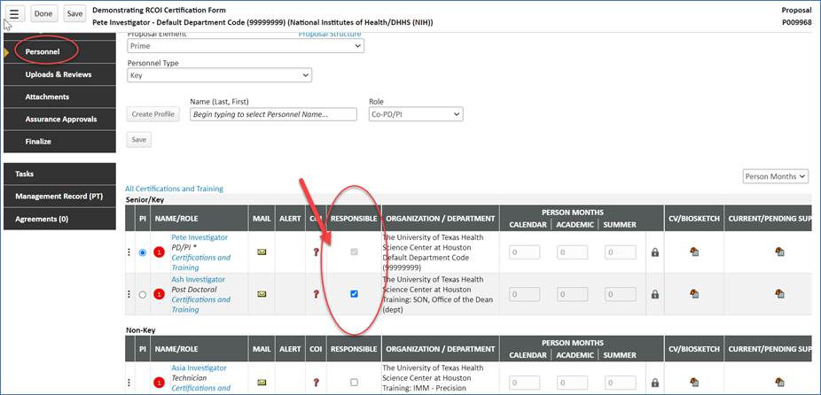
Submitting rcoi forms in start

Slide 7
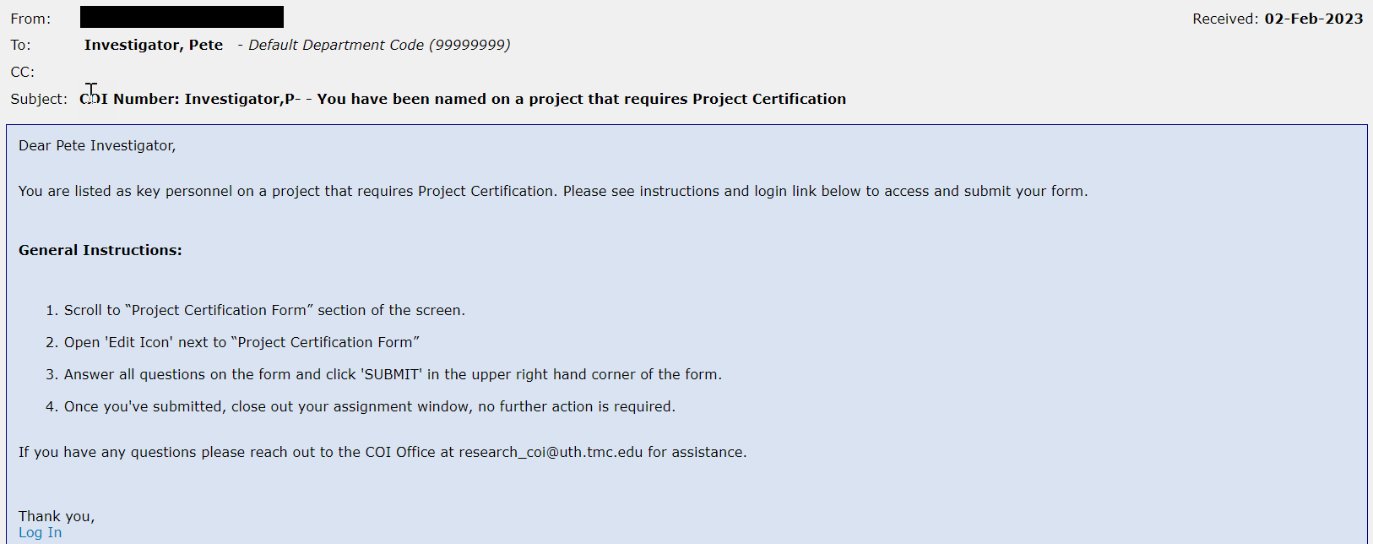
Submitting rcoi forms in start
Automatic Monitoring – Triggers from Statuses and from the Responsible checkbox
-Guarantee Requested; Awarded: Processing; Agreement in Negotiation; Active; Final Review: Agreements
- Final Review: Agreements – Modified Route specific to Proposal Type CTA/Monetary Agreements

Slide 8
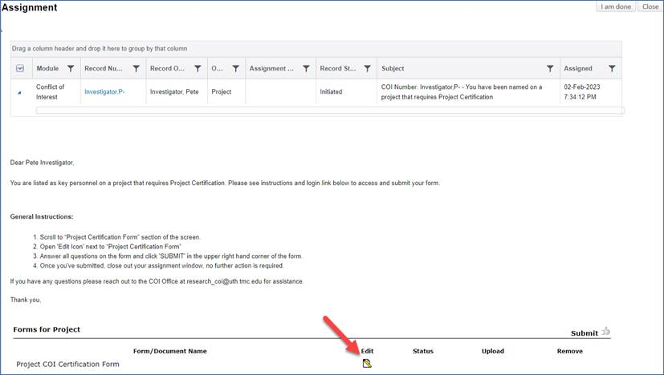
Submitting rcoi forms in start

Slide 9
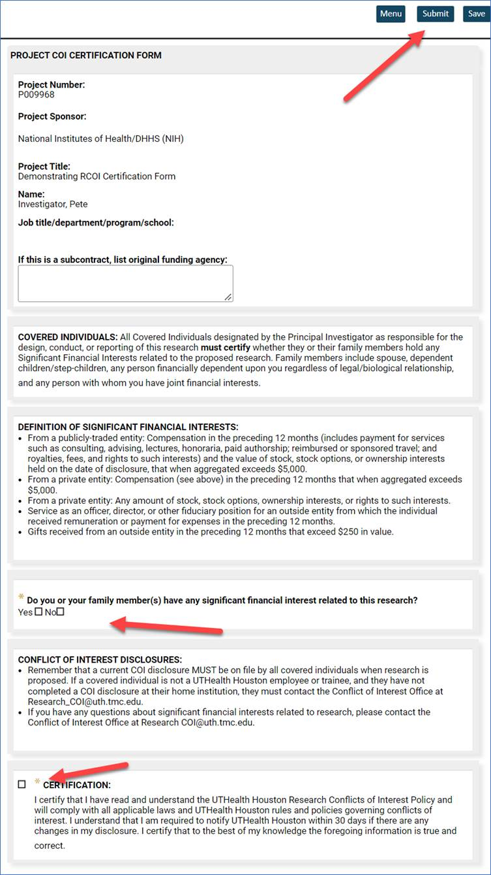
Submitting rcoi forms in start

Slide 10
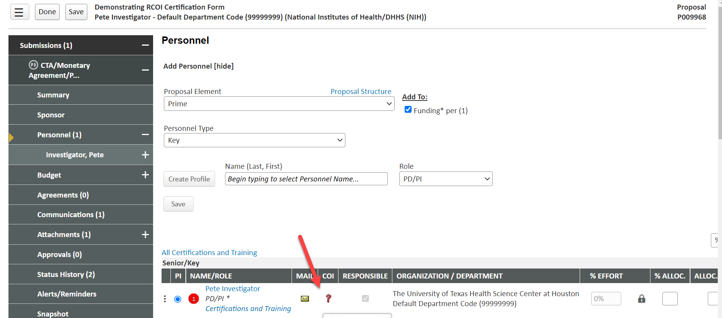
Department Administrators (DA I ROLE) Can View Project statuses in the COI module

Slide 11
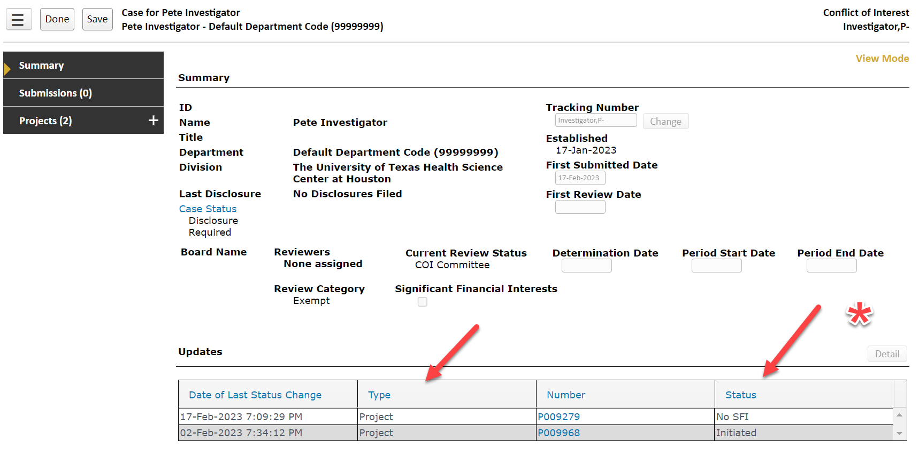

Slide 12
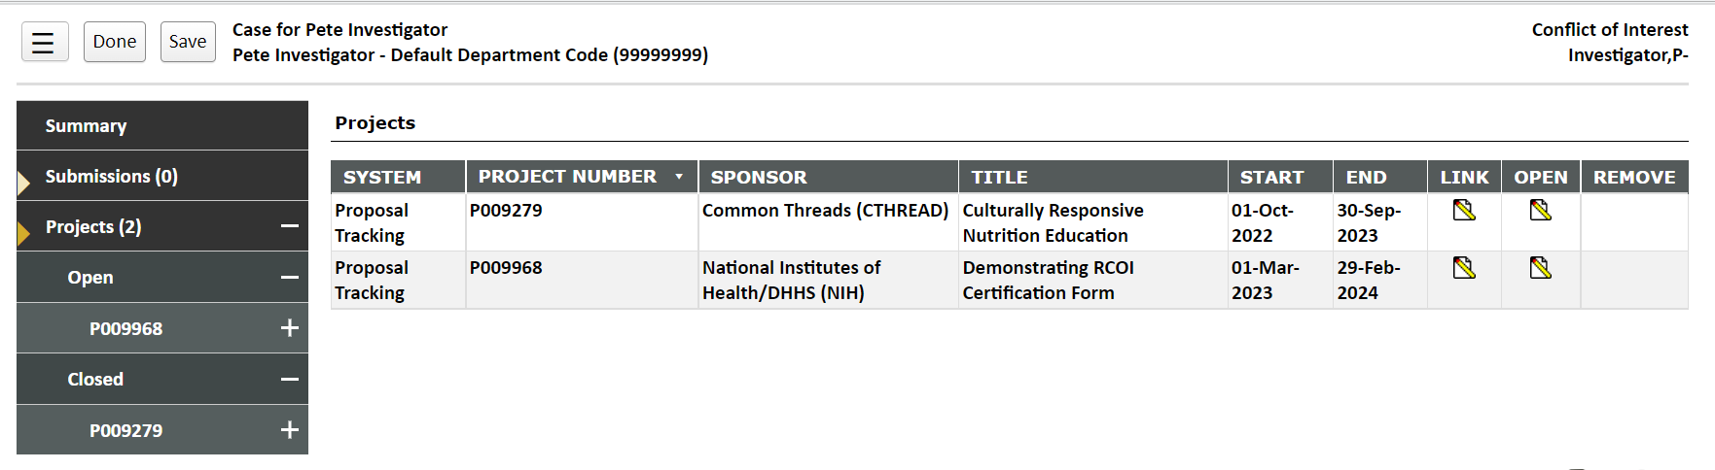
Open indicates form still needs to be submitted or is under review at COI office
Closed indicates form has been submitted (Preloaded projects will also sit in this status)

Slide 13
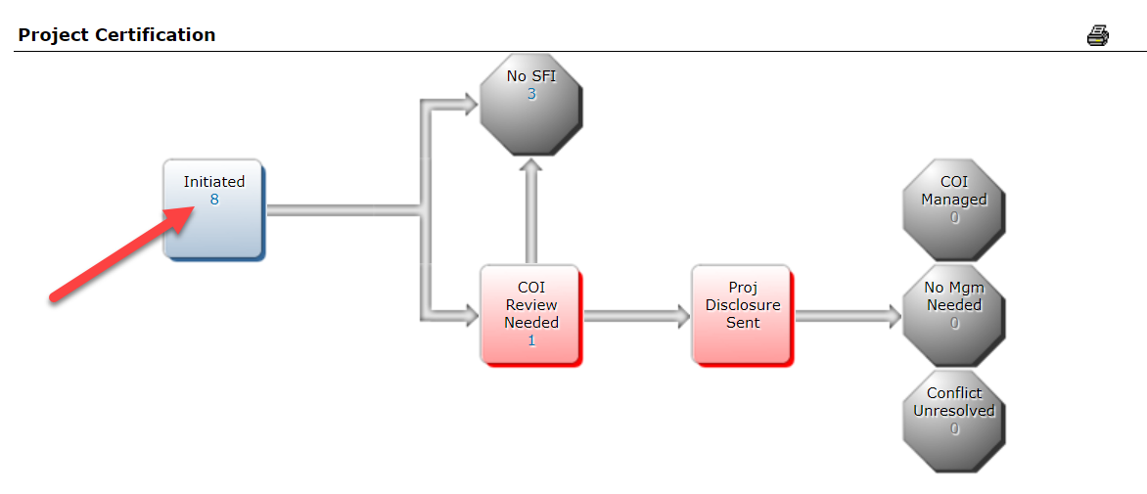
WORKFLOW MAP ENABLED FOR DA I ROLE

Slide 14
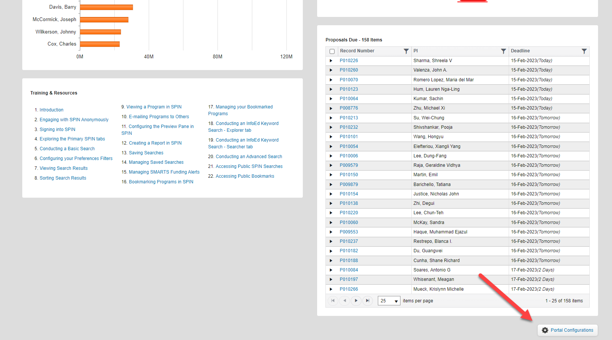
Home Page in UTStart

Slide 15
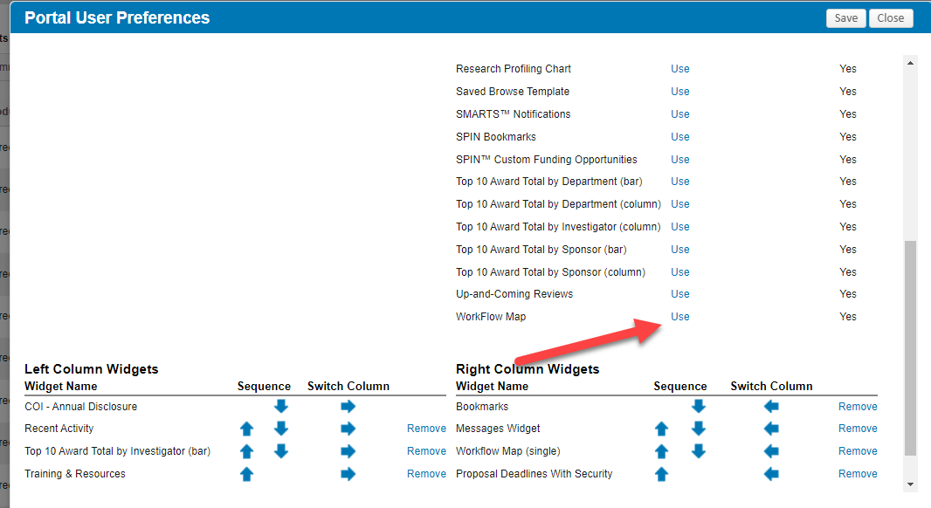

Slide 16
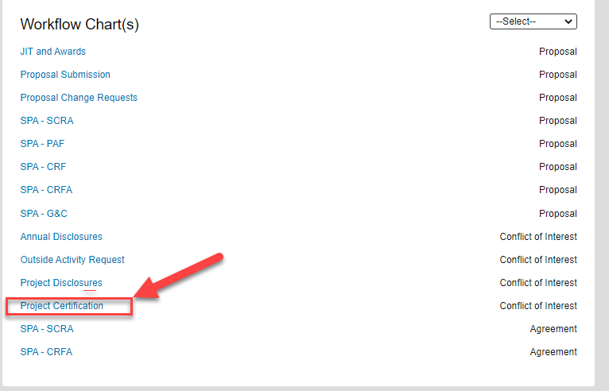

Slide 17
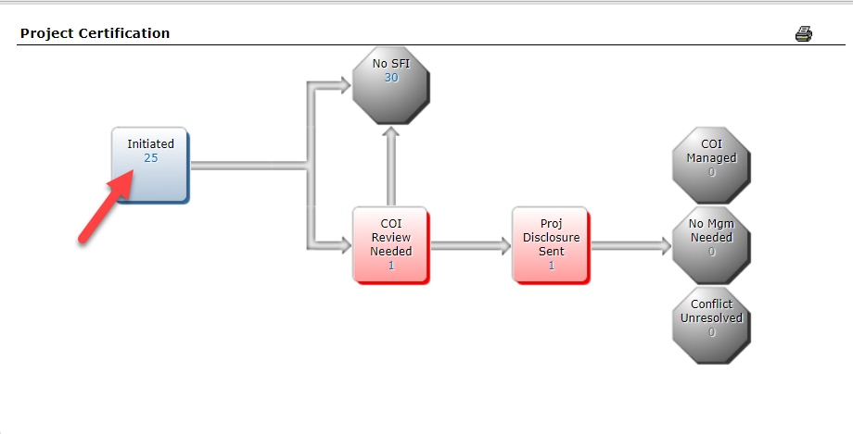
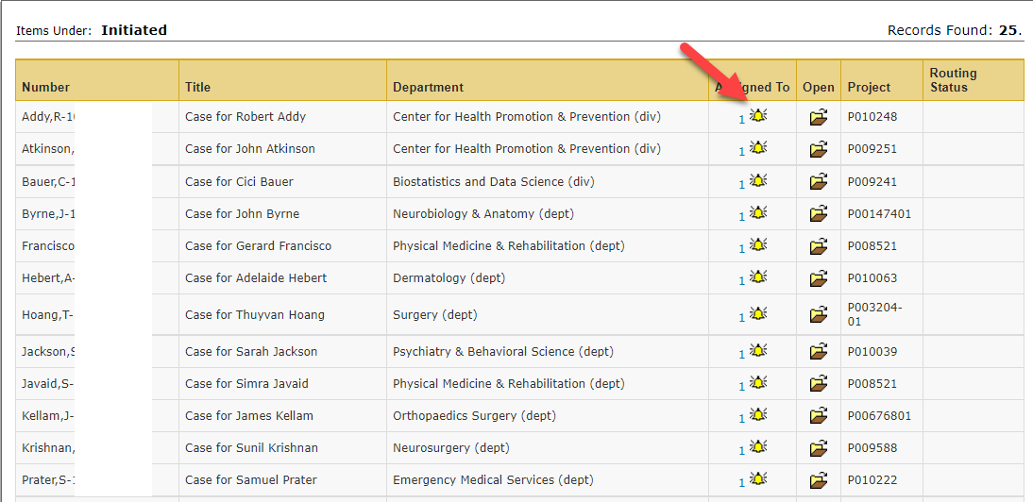
WORKFLOW MAP ENABLED FOR DA I ROLE

Slide 18
SPA Award Processing Team – A Trial

Slide 19
Award Processing Team
Dedicated Award Processing Team will be established to reduce award setup times & create continuity for the departments
Awards are assigned to the Team once a NoA is received
  Team members assigned to departments – you will “know” who is processing your action item
  Team will proactively request all award setup items by email to PI & department admins:
    Assurances/RCOIs
    Updated Budgets
    Confirmation of faculty effort and Work Start Date
    Subcontract SOWs
  Team will notify all Faculty/departments by email once the FMS is ready for use
Goal is to reduce CTMs, retro PAs and other “surprises” once an award is received

Slide 20
Subin Proposal Status Inquiries

Slide 21
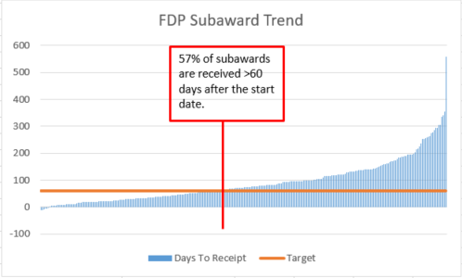
Subin proposal status

Slide 22
Subin proposal status
Negative Impacts:
Need to set up guarantee account, IF you know it was funded or,
Late cost transfers / effort reporting Issues
Unbilled accounts receivable balances
“Churning” (Status checks)
Science delays

Slide 23
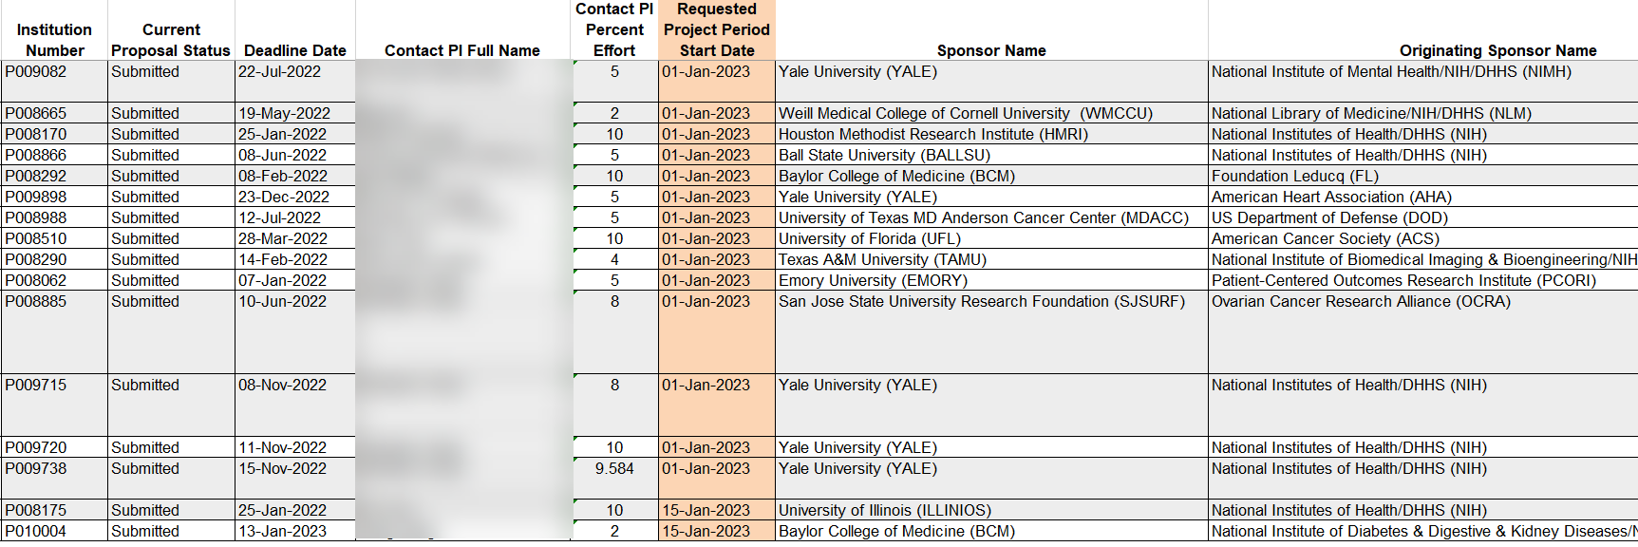
Subin proposal status

Slide 24
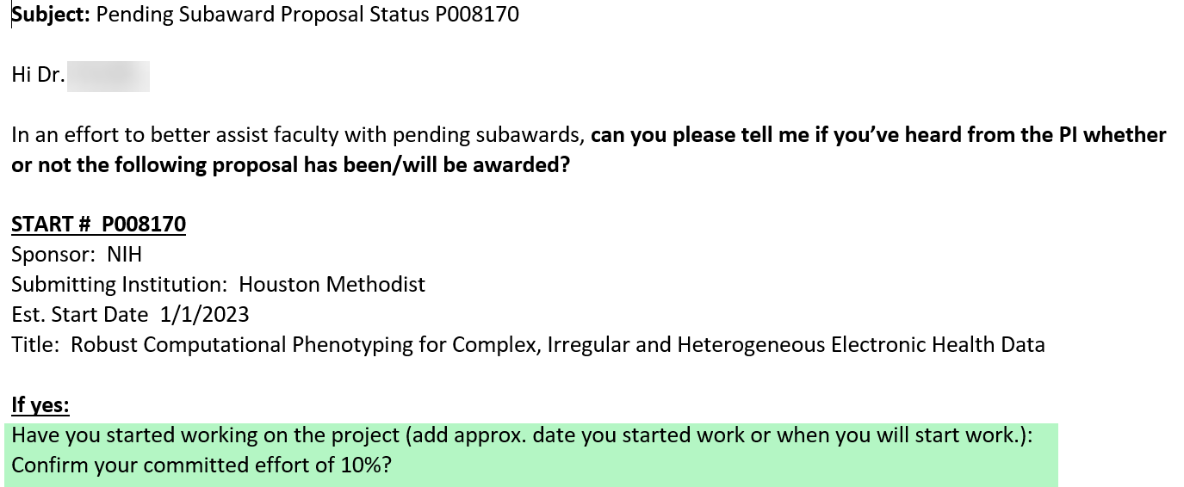
Subin proposal status

Slide 25
Subin proposal status
19 pending sub-ins with JAN 2023 proposed start date:
15 Unique PIs:
      7 not funded
      1 still pending and in JIT
      1 PI left UT
      4 PIs did not respond, followed up 2/19/23
      6 confirmed awarded and UT has started work on the project
          All 6 were still in submitted status at time of inquiry
              No Guarantees, No subaward agreements yet received

Slide 26
Subin proposal status
SPA’s Proactive Approach:
Email PI in month the proposal was to start
  Confirm work start date if funded
  Confirm committed effort of PI
If funded, initiate guarantee request and notify department G&C team
  If not funded, update status in START
  February emails sent out on 2/19/23

Slide 27
SRA Level Up Training (1 year review)

Slide 28
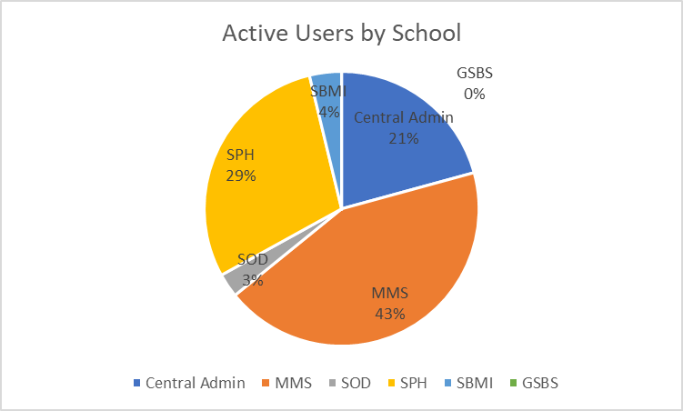
SRAI LevelUp user Statistics
SRAi LevelUP available to UTHealth research administrators and staff 4/1/2022.
To date there are 106 active users throughout the institution.

Slide 29
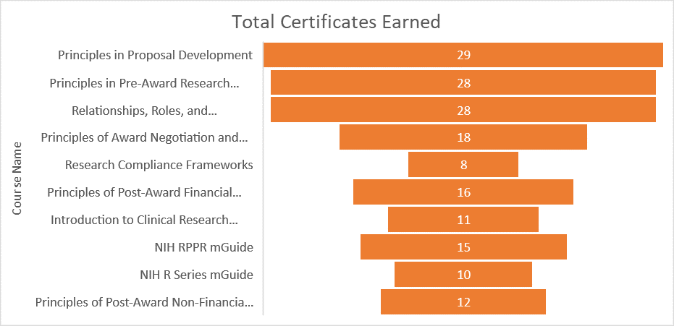
SRAi Levelup Course Statistics
9 modules: in-depth learning courses that go over large topical areas and are completed by taking a 50-question assessment (2-5 hours to complete).
2 mGuides: compact learning experiences that serve as ‘how-to’ guides for the learner to understand a specific skill set. (1 hour to complete). Completing 3 mGuides is equivalent to one module.

Slide 30
SRAi Levelup suggested course order
Relationships, Roles, and Responsibilities in Research Administration
Principles in Research Development
Principles in Pre-Award Research Administration
Principles in Proposal Development
NIH R Series mGuide
Principles of Award Negotiation and Set-up
Principles of Post-Award Financial Research Administration
Research Compliance Frameworks
NIH RPPR mGuide
Principles of Post-Award Non-Financial Research Administration
Introduction to Clinical Research Management: Clinical Studies and Trials

Slide 31
SRAi Levelup FAQ’s
You have one year from start of module or mGuide to complete the course. Within that time, you may complete the coursework at any time that works best for you and your schedule.
Use the courses as a supplement for CRA preparation.
Upon passing the assessment, learners will receive an email with instructions on how to download their LevelUP badge and showcase it on various platforms.
Registration Form.
SPA.Training@uth.tmc.edu

Slide 32
Effort Reporting Updates

Slide 33
Outstanding individual statements
July 2021-Februrary 2022
March – August 2022
Total Outstanding = 36
Total Outstanding = 113

Slide 34
Outstanding Project statements
July 2021-Februrary 2022
March – August 2022
Total Outstanding = 84
Total Outstanding = 169

Slide 35
Delegating Certification
Since March 2022, SPA utilizes a proxy/project designee system for PIs who are no longer with UTHealth
No “partial” delegation is permitted
To assign a Proxy for a PI who has left UTHealth
Email to Effort@uth.tmc.edu
Name and Employee ID of PI
Name and Employee ID of faculty supervisor, Chief, or Chairman

Slide 36

Tips for the upcoming reporting period
For any expected cost transfers, please leave statements in “Ready for Pre-Review” status
Journal Entries → Send journal IDs to effort
Minimum/Maximum Effort Waiver Justification
  Cause
  Plan
  Timeline

Slide 37
Tentative Schedule for 9/1/22-2/28/23 Period
Pre-Review period opens
Certification closes
March 20, 2023
April 4, 2023
May 5, 2023
Certification period opens
Effort Reconciliation
2 Weeks
~1 Month
~2 Months

Slide 38
Q & A

